Slide 1
Computer Networks
Review

Slide 2
Important Sections
1.4
2.1.3、2.5、2.6
3.1-3.4
4.2.2、4.2.5、4.3、4.4.1、4.5.1、4.8
5.1、5.2.4、5.2.5、5.6
6.1、6.4、6.5
7.1、7.2、7.3
8.2、8.3、8.4、8.5、8.7

Slide 3
Most Important
Concepts

Slide 4
Chapter 2
Signal rate vs. Data rate
  The Nyquist Theorem → no noise
  Shannone’ Theorem → has noise
Modem vs. codec
Multiplexing
  TDM(A), FDM(A), CDMA
Telephony Network

Slide 5
Chapter 3
Framing
  Bit stuffing
Error control
  Hamming Distance
  CRC
Protocol
  Stop and wait
  Sliding Window
    Go-Back-N, Selective Repeat

Slide 6
Chapter 4
Ethernet
  Frame Format
  Switch
    VLAN, STP
  CSMA/CD
    Collision Detect
    Binary exponential back-off
WLAN
  MACA, CSMA/CA
    RTS/CTS

Slide 7
Chapter 5
Datagram vs. Virtual circuit
Routing Protocols
  Distance vector: RIP, BGP
  Link state: OSPF
IP4
  Address, subnet mask, Packet format
  ARP, ICMP
  Routing, NAT
IP6: address length

Slide 8
Chapter 6
TCP
  Segment format
    Sequence, Ack, Windows
  Connection management
  Transmission policy
  Congestion control
  Socket primitive

Slide 9
Chapter 7
DNS
  Name space, name lookup, resource record type
Email
  SMTP, POP3, MIME
WWW
  HTTP: method, cookies
  HTML tag
  Dynamic document generated method
    client side, server side

Slide 10
Chapter 8
Cryptographic
  Symmetric Key vs. Public key
  Algorithms name & key length
Digital Signature
  Private key, Message digest
  Public key management, chain of certificates
Authentication Protocols and attack
  Reflection attack, man-in-middle attack
SSL

Slide 11
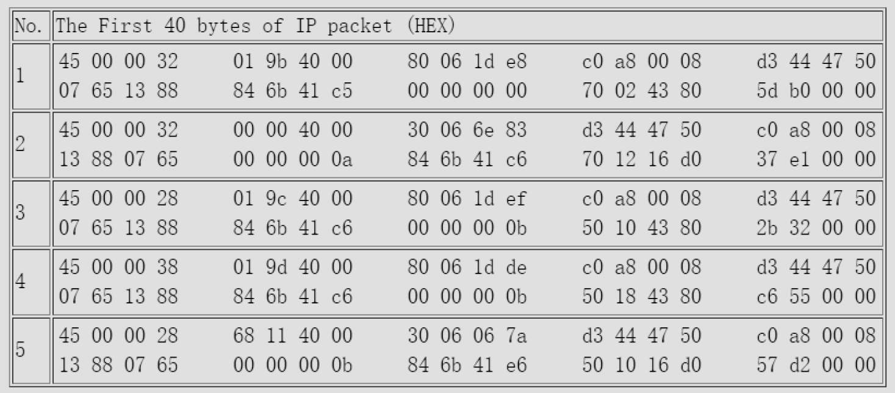
TTL
数据报长度
数据协议，06为TCP
src
dst
IP
TCP
src port
dst port

